Slide 1
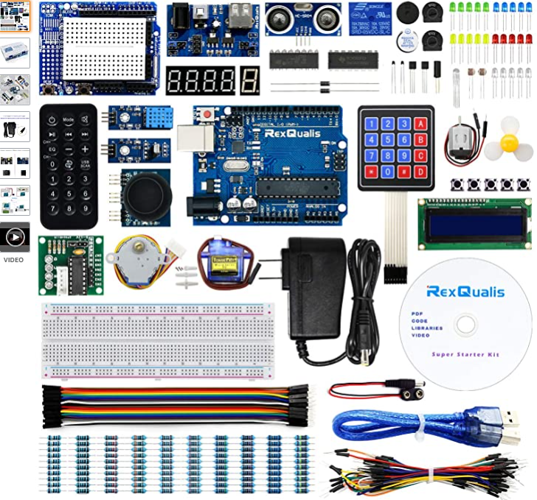




ELECTRICAL
Microcontroller Design
Raha Riazati
04/16/21
Ordering!
Arduino Uno R3-based microcontroller kit
Same pin configuration, power adapter, LED’s
Small adjustments to make program fit for
Arduino Uno R3 (pin numbers, etc.)
Fixed timing (50 ms), looked into interfacing with
switches instead of just a LED
To-Do: Look for testing platforms to use with Arduino IDE, more tutorials on interfacing with switches/optimizing design

